Slide 1
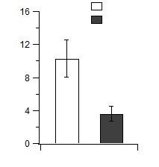
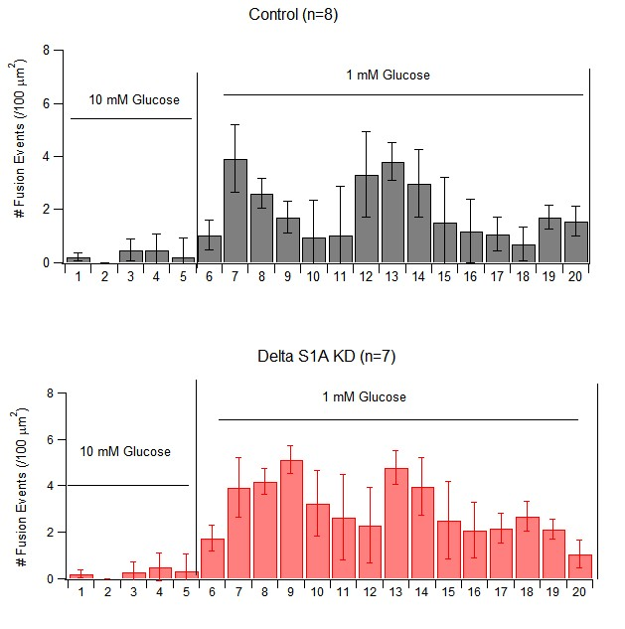
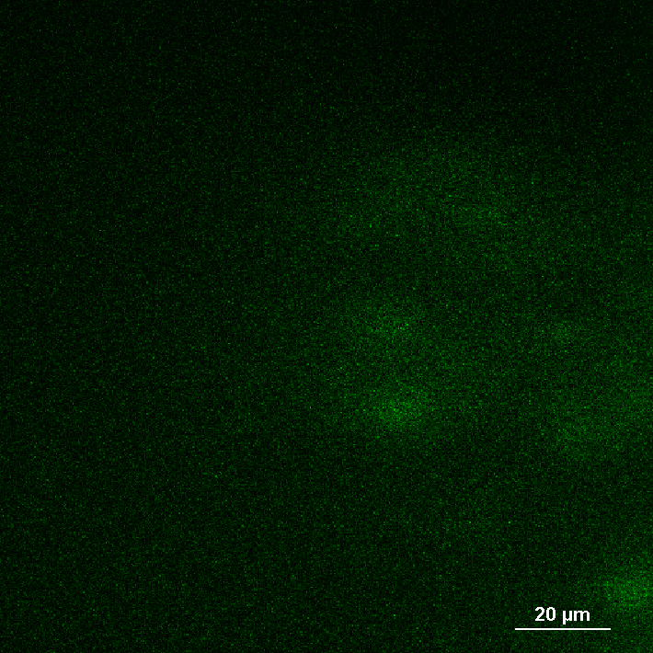
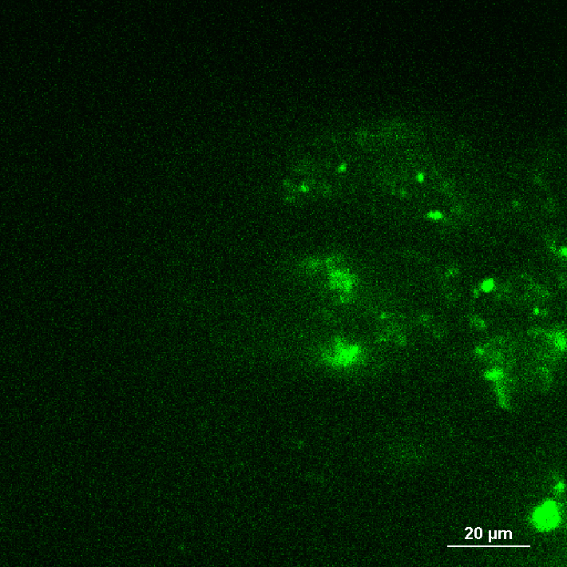
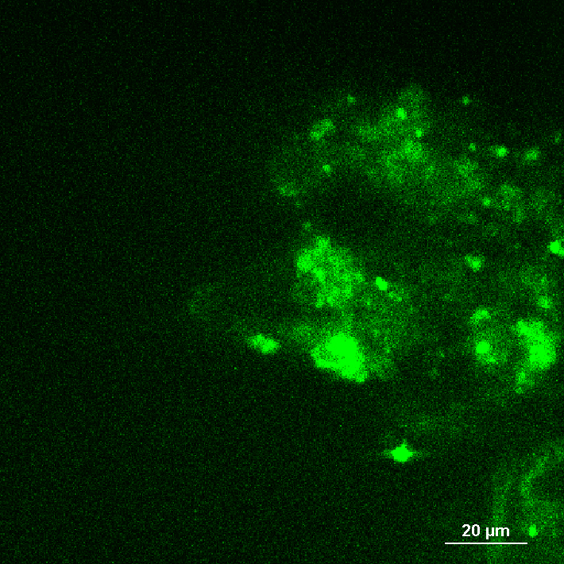
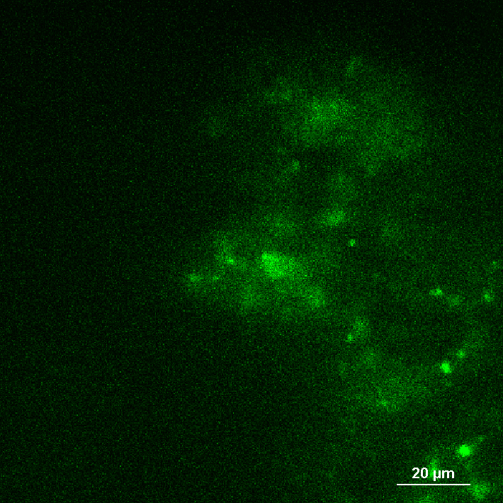
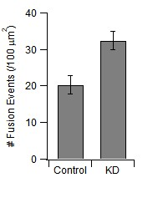
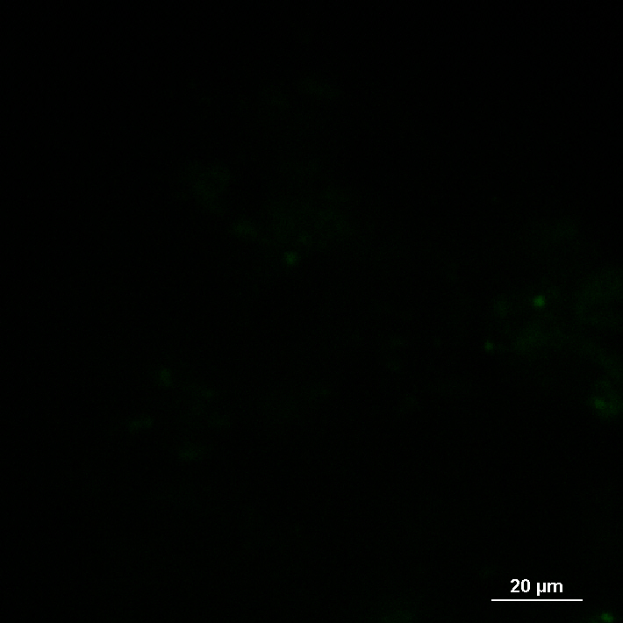
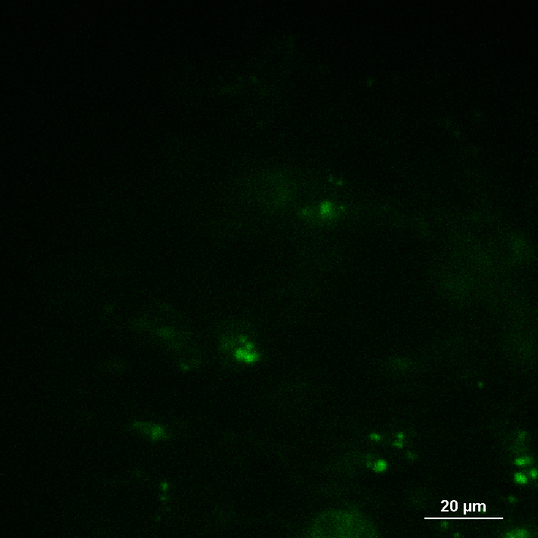
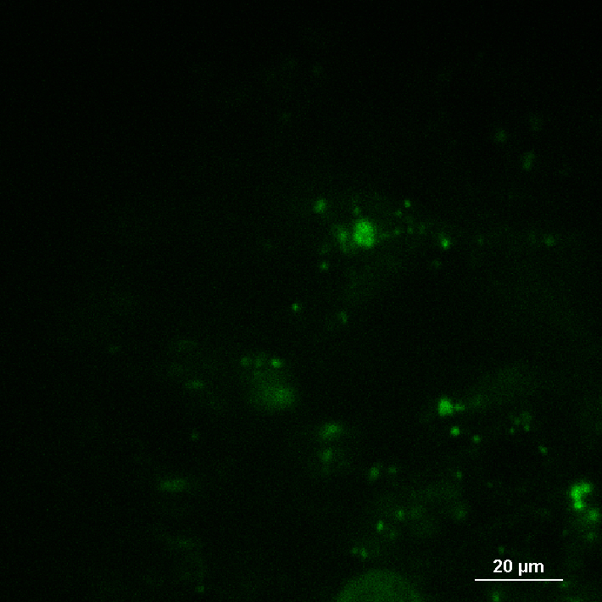
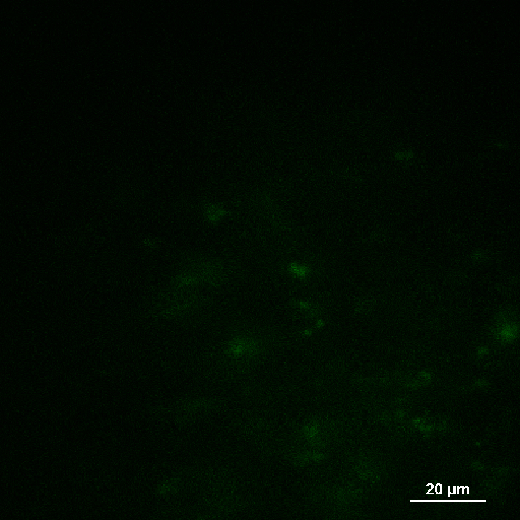
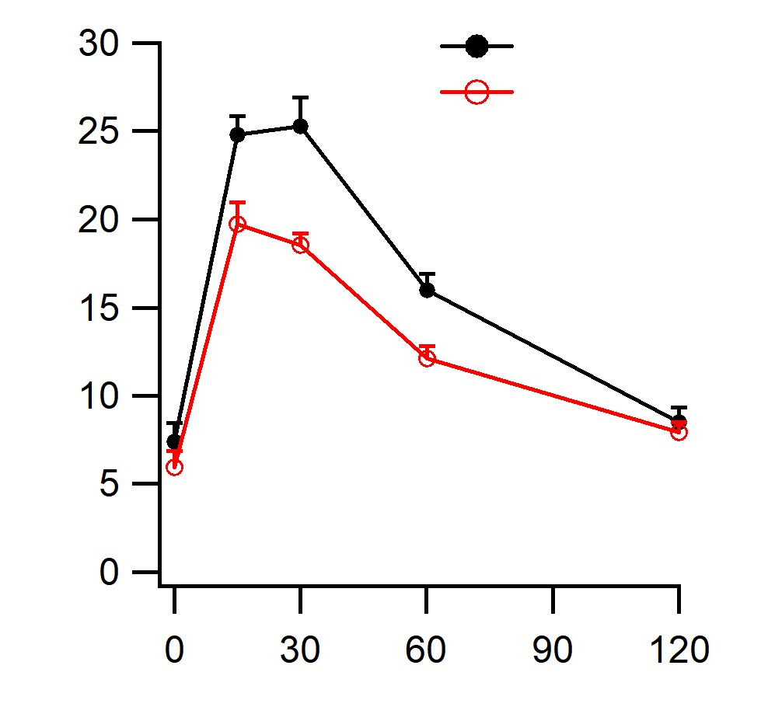
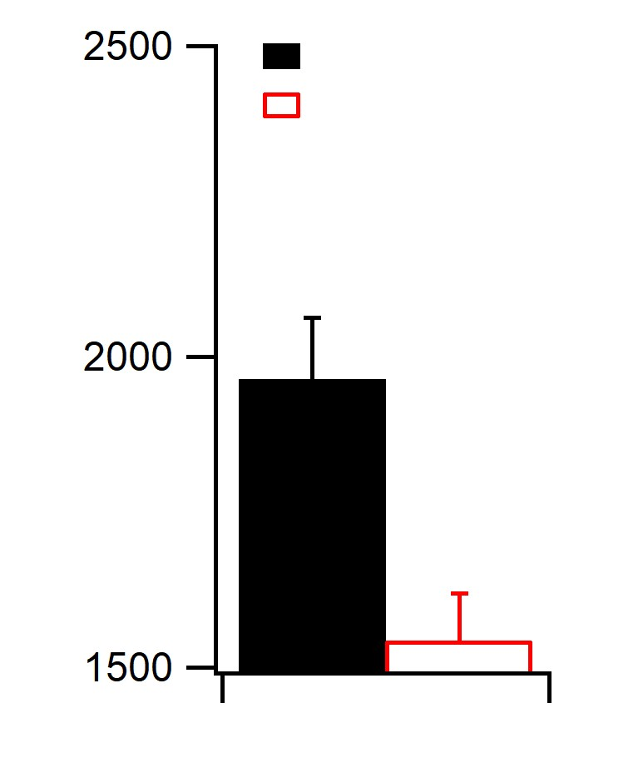
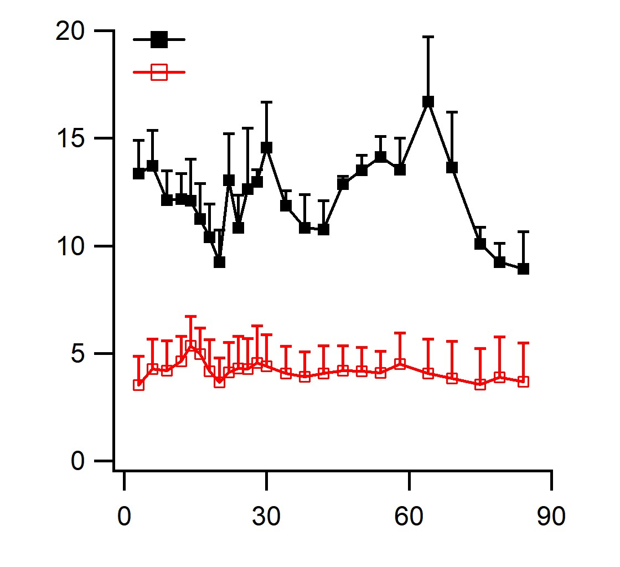
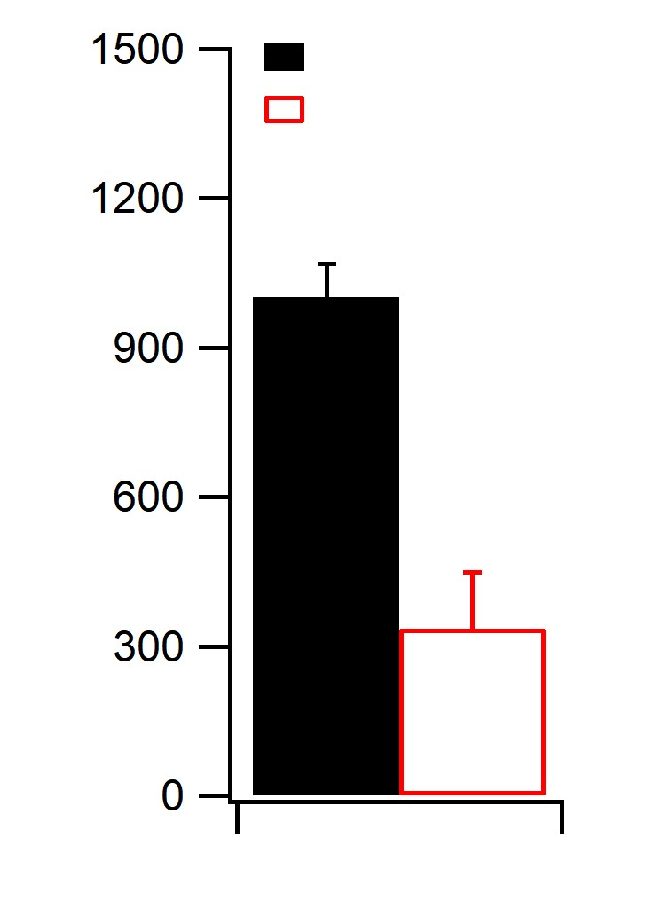
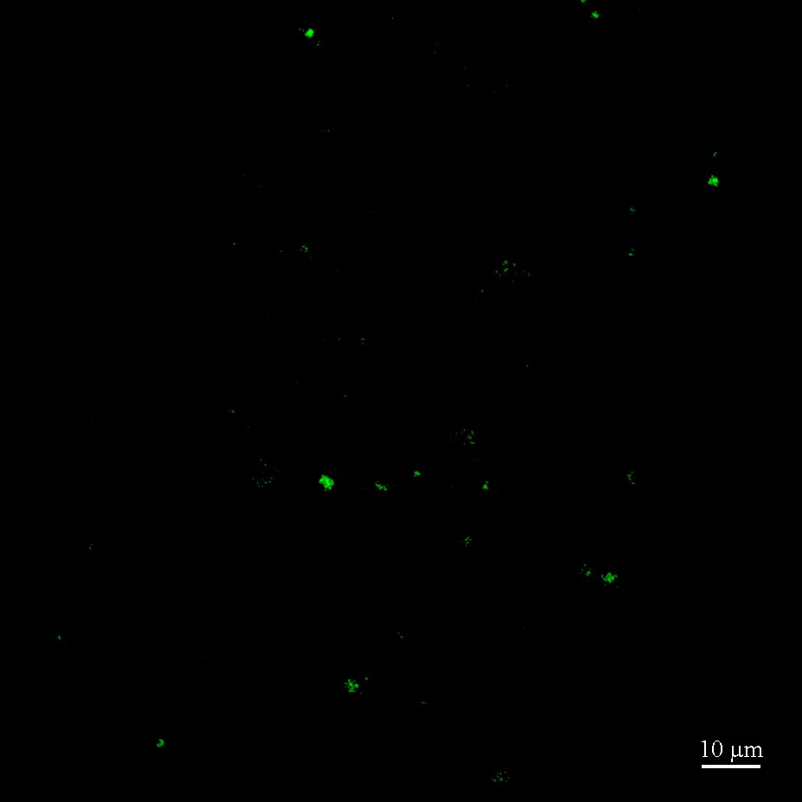
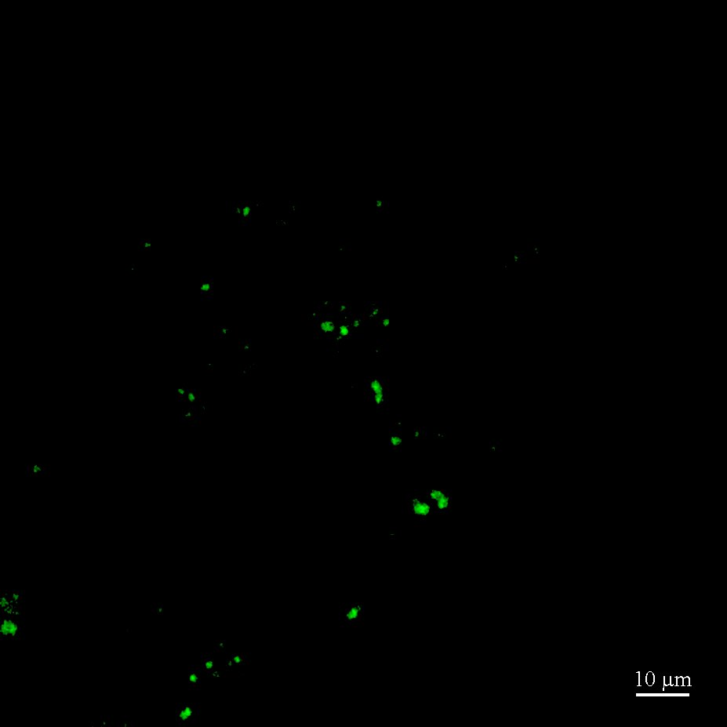
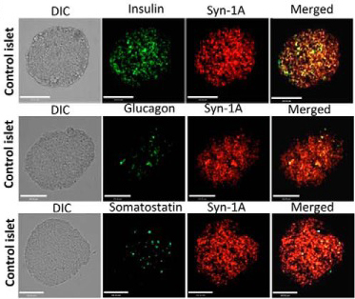
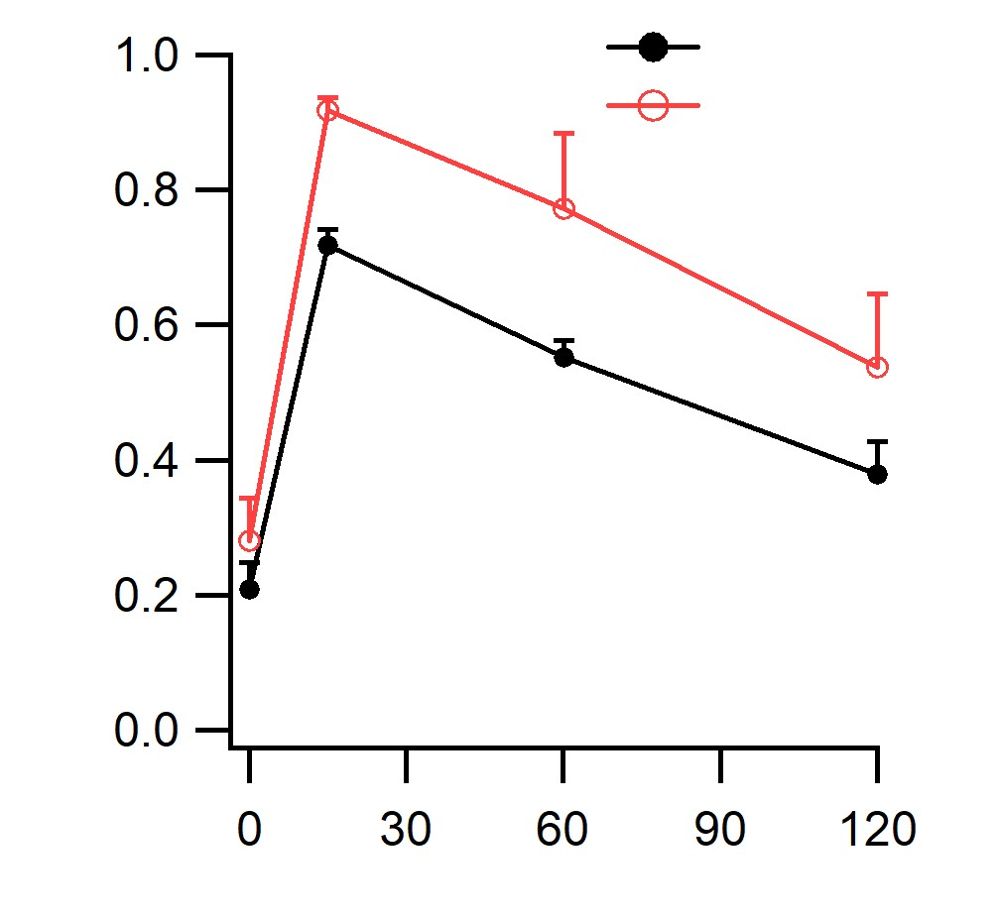
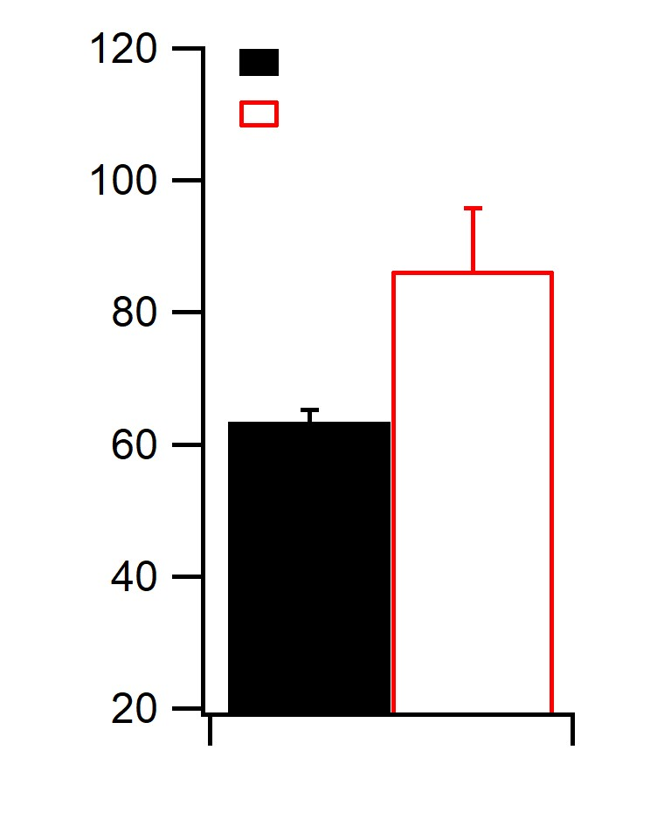
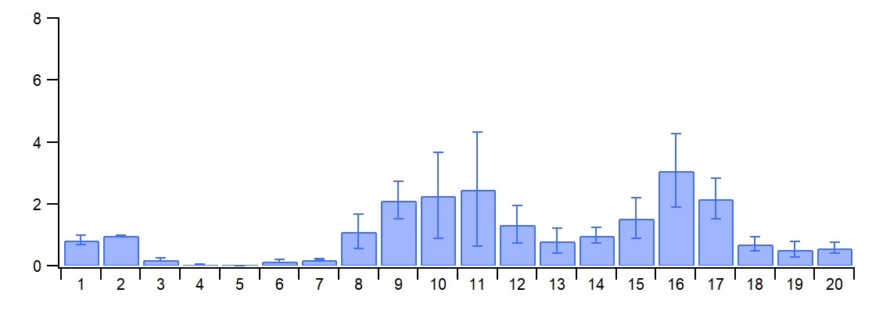
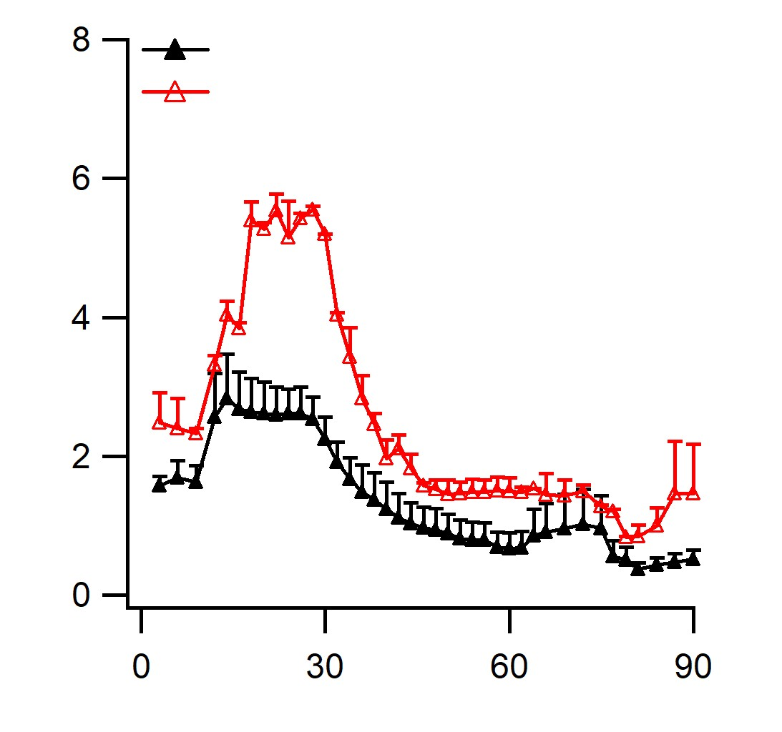
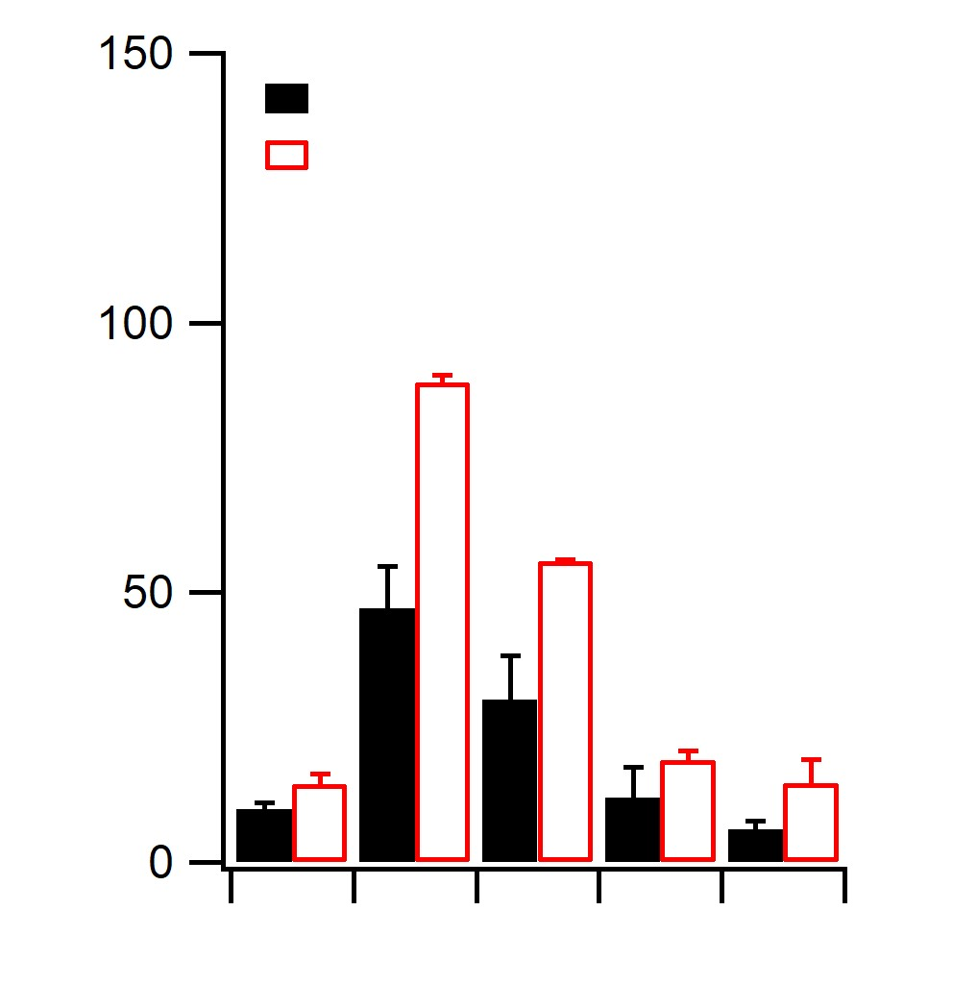
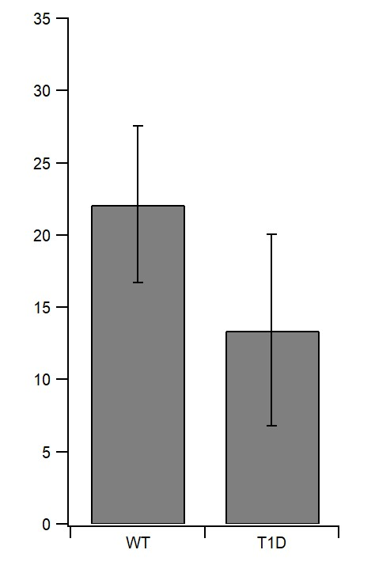
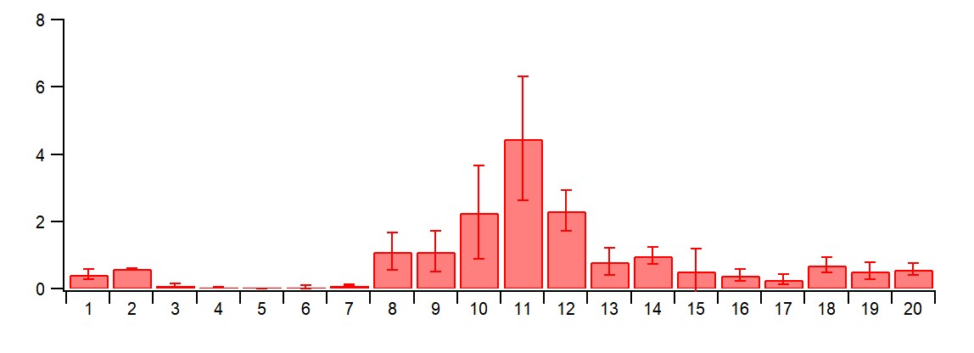
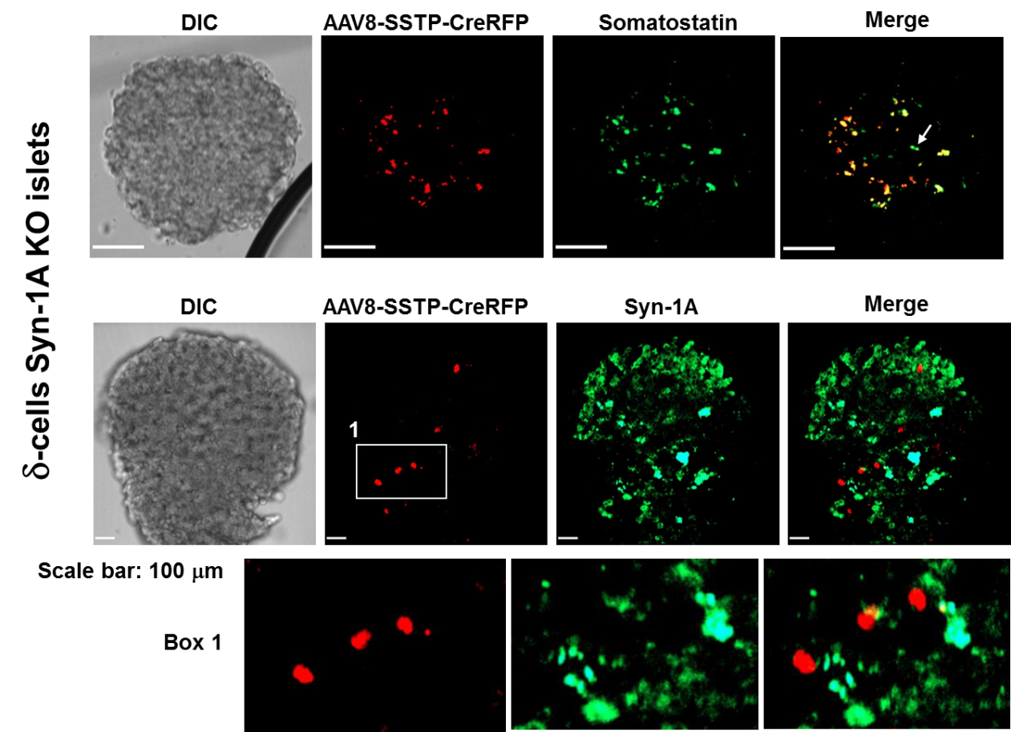
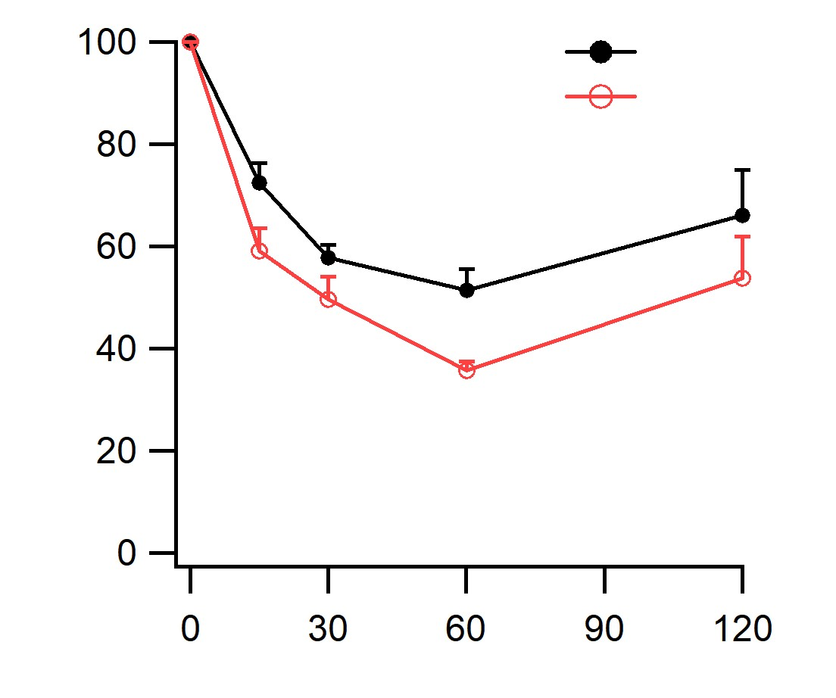
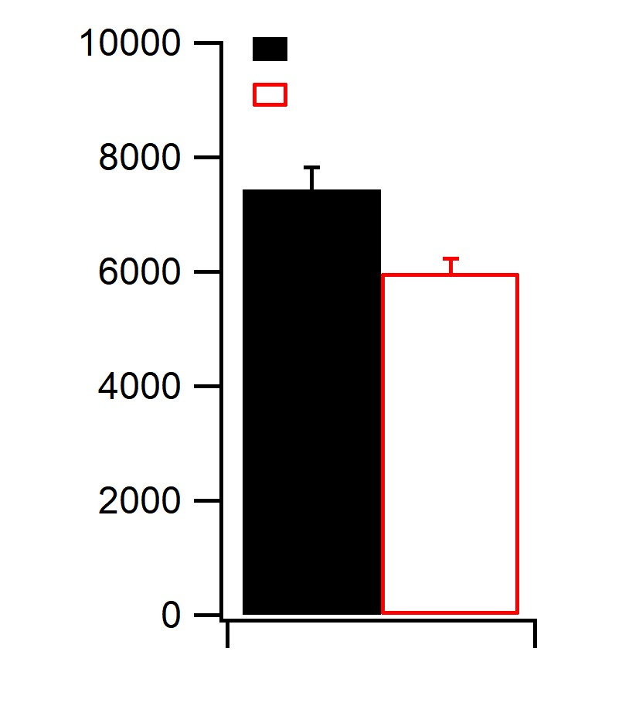
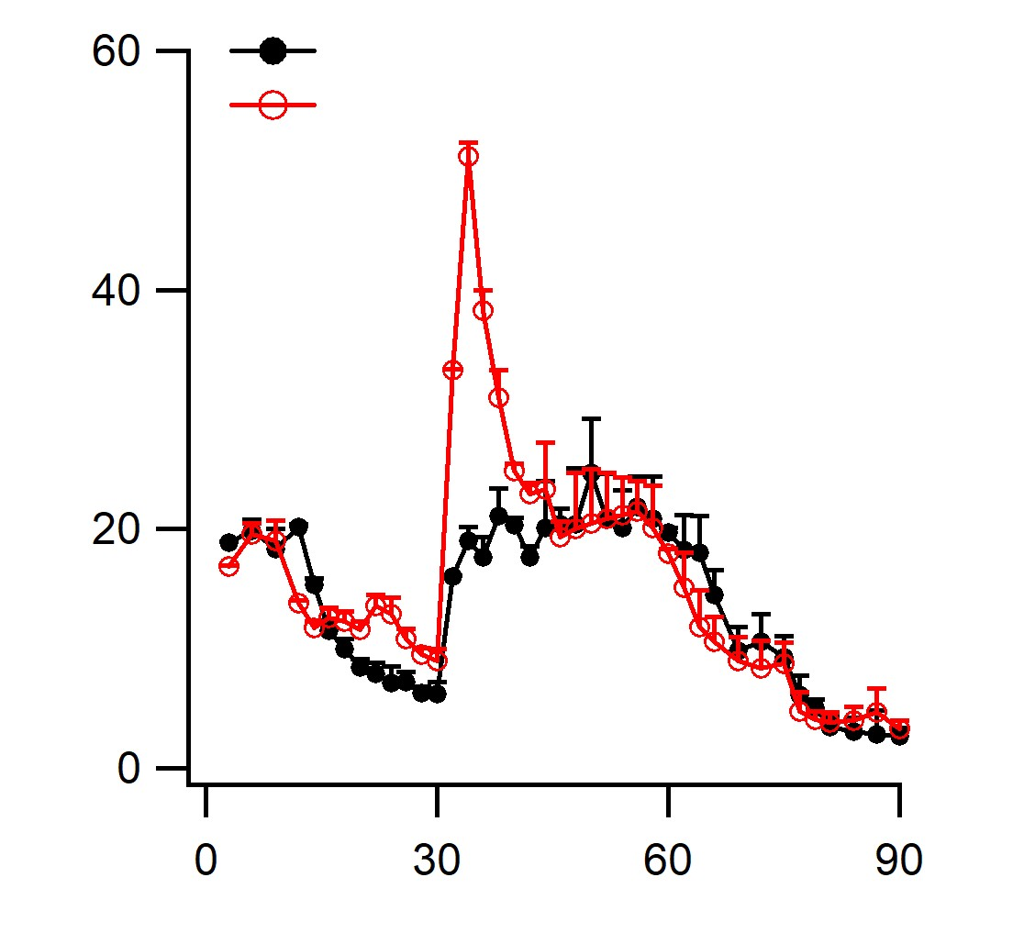
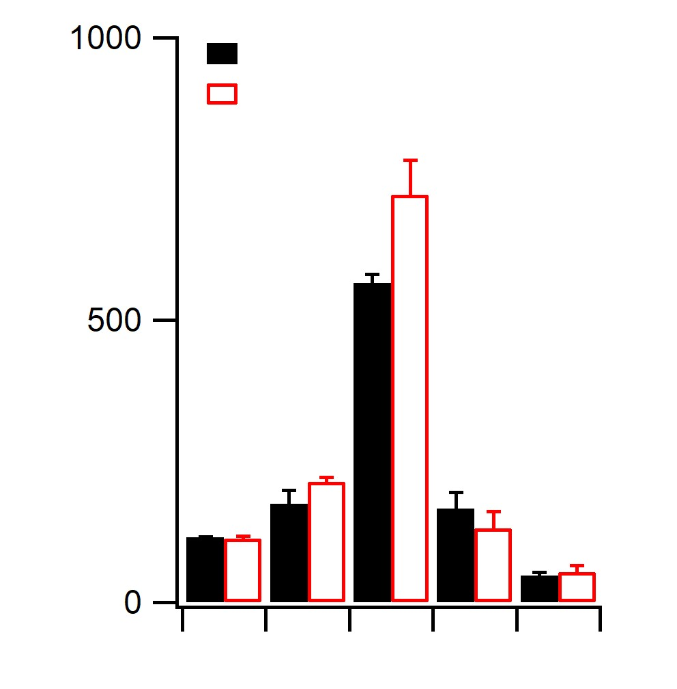
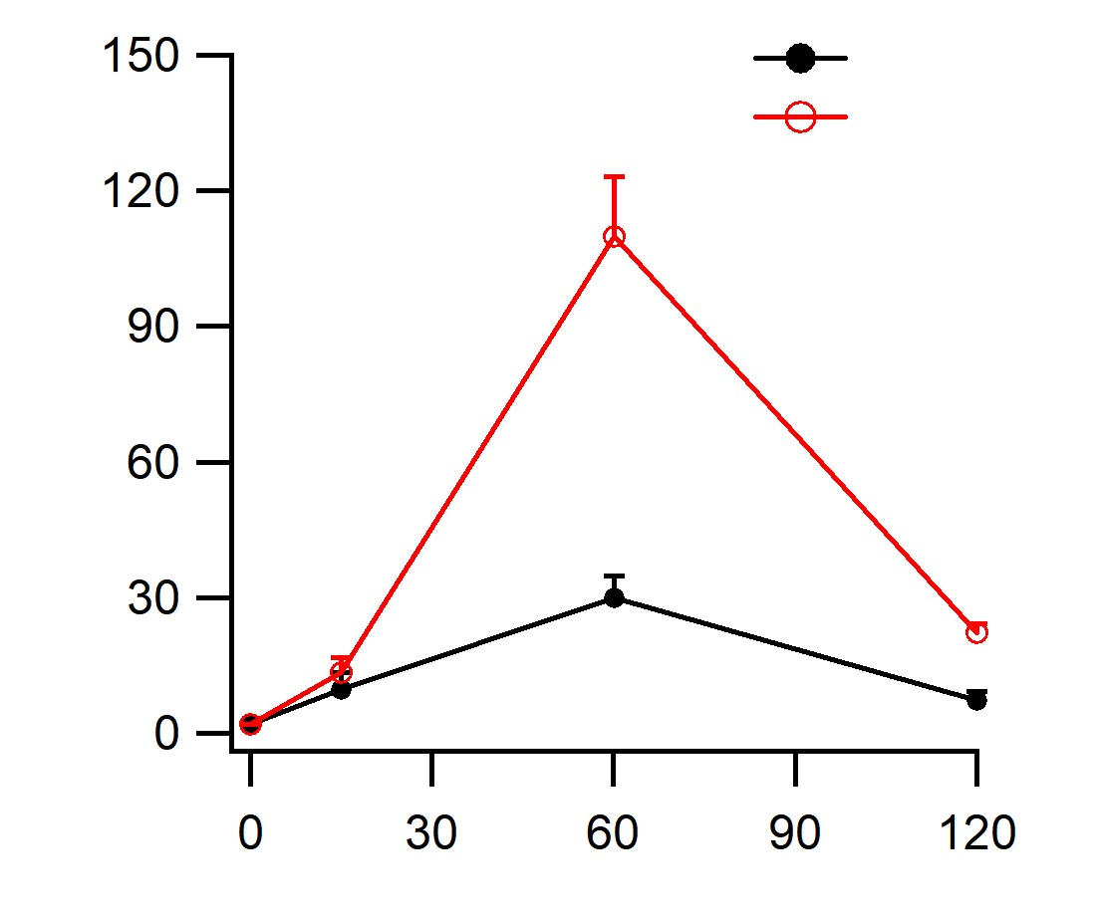
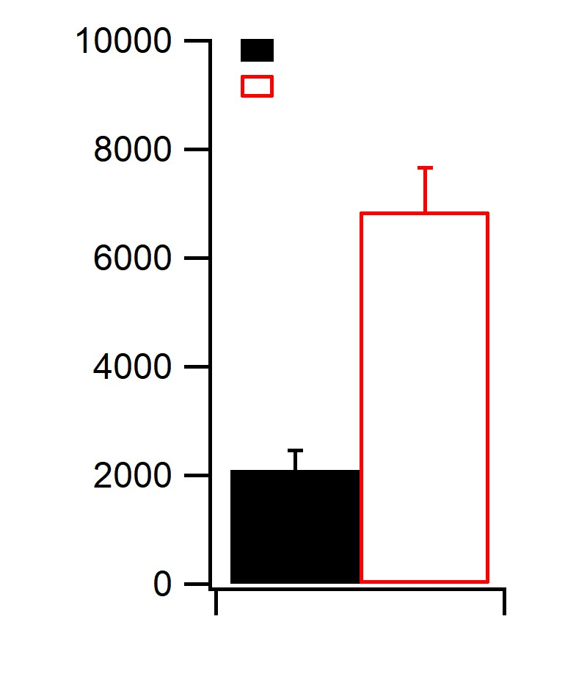
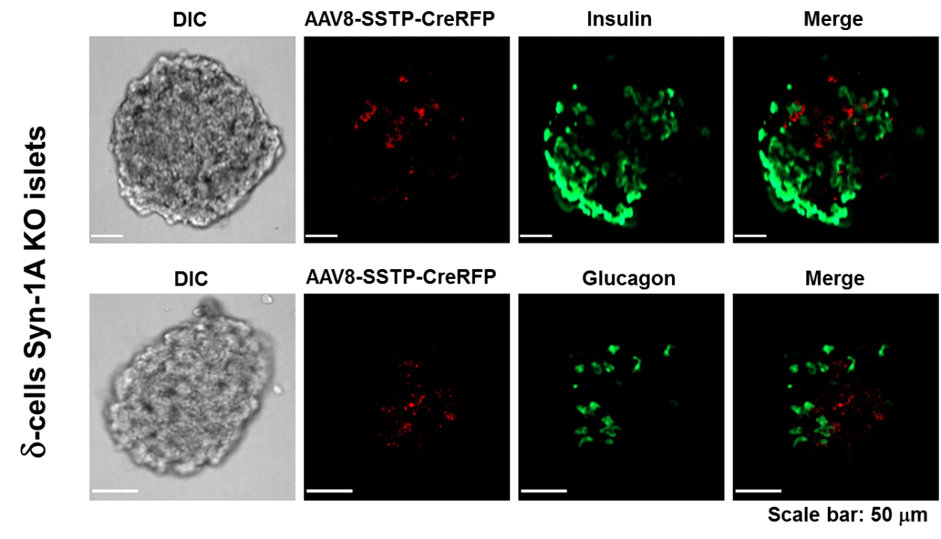
δ-cell exocytotic blockade by syntaxin-1a deletion restores α-cell glucagon secretory response sufficient to counter insulin-induced hypoglycemia
Tairan Qin, Tao Liang, Li Xie, Herbert Gaisano
Departments of Medicine and Physiology, Temerty Faculty of Medicine of the University of Toronto, Ontario, Canada
Abstract
Syntaxin-1A is the key SNARE protein that forms the putative membrane-fusion SNARE complex mediating secretory granule exocytosis in neurons and neuroendocrine cells, including the 3 major islet cell types. We here induced δ-cell exocytosis blockade by treating Syntaxin(STX)-1A flox/flox mice with intraperitoneal injection of adeno-associated virus (AAV8)-SST promoter-Cre/RFP.
Immunocytochemistry demonstrated STX-1A deletion only in the red-colored δ-cells as verified by SST and Cre antibody staining. δ-cell STX1A knockdown (KD), compared to WT mice, showed improved glucose homeostasis with larger biphasic rise in blood insulin levels during IPGTT; and ITT (insulin injection) showed improved insulin sensitivity with larger increases in glucagon release (60 min and 120 min). Whole pancreas perfusion performed on KD vs WT mice showed the following: 1) confirmed the reduction and flattening of stimulated SST secretion; 2) a higher increase in glucose (10 mM)-stimulated insulin secretion that was suppressible by exogenous SST to the same level as WT mouse pancreas; and 3) a much higher hypoglycemic (1 mM glucose) induced glucagon release that was also suppressible by exogenous SST to the same level as WT mouse pancreas. Whole islets exocytosis imaging with NPY-pHluorin that’s specifically expressed in δ-cells and α-cells within pancreatic slices showed suppressed somatostatin secretion and correspondingly increased glucagon secretion in STX-1A KD islets.
1 mM Glucose
10 mM Glucose
Control (n=8)
***
10 mM Glucose
1 mM Glucose
**
Control
Control
#Fusion Events (/100mm²)
δ-STX-1A KD (n=7)
δ-cell Stx-1A KD
δ− cell
Stx-1A KD
Delta S1A KD
Control
20 μm
Figure 2. Exocytosis imaging of STX1A-KD δ−cells. Pancreas slices from KD mice and control mice were infected with Ad-DIO-NPY-pHluorin for 30h, then performed the sequence of low glucose (1 mM for 3 mins)- high glucose (10 mM for 13 mins) stimulation protocol. δ−cell-specific Cre expression turns on the DIO (double-floxed inverse ORF)-NPY-pHluorin signal, which enabled us to observe in real-time a reduction in whole islet δ-cell exocytosis by 65% caused by the e STX1A KD (Control: 10.31±2.3 events/100 mm², N=6 slices: KD: 3.66±0.9 events/100 mm², N=5 slices). Control is WT mice with AAV8-SST-Cre/RFP to identify red δ-cells. *P < 0.05,**P<0.01, ***P<0.001. Statistical significance was assessed by 2-tailed Student’s t test, and it was also appllied to the follwoing figures.
Figure 3. Exocytosis imaging of α-cells within an islet from δ-cell STX-1A KD and control mice. Pancreas slices from KD mice and control mice were co-infected with AAV-GCG-Cre (from T Kieffer, Vancouver) and Ad-DIO-pHluorin for 4 days to target NPY-pHuorin expression only to α-cells, then performed high glucose (10 mM for 15 mins) - low glucose (1 mM for 5 mins) stimulation protocol and monitor the α−cell exocytosis within an islet. δ-cells were excluded by the red signal caused by AAV8-SST-Cre/RFP. Results showed that the δ-cell exocytosis blockade caused by δ-cell STX1A KD increased the number of fusion events from α-cells across the islet by ~65%.
Introduction
The pancreatic islet is a complex micro-organ that regulates glucose homeostasis from the actions of major hormones secreted from three endocrine cell types (β-cell, α-cell and δ-cell) which become severely perturbed in type-1 diabetes (T1D), particularly in their paracrine cross-talk. A major complication in T1D is iatrogenic hypoglycemia wherein α-cell become insensitive to low glucose induced by insulin treatment. α-cell ‘glucose blindness’ has been attributed to δ-cell somatostatin (SST) inhibition of α-cell that becomes accentuated when β-cells are destroyed in T1D, but the precise mechanism to explain these effects is not completely understood; and the visualization of the precise secretory kinetics of these islet cells within an intact islet have not been demonstrated.
A
GTT
A
2.8 mM Glu
10 mM Glu
1 mM Glu
*
**
Control (N=6)
KD(N=6)
Control (N=6)
KD(N=6)
Somatostatin Secretion
Control (N=3)
KD(N=3)
0 min
2 min
7 min
20 min
Blood Glucose (mmol/L)
**
**
Control (N=3)
KD(N=3)
**
AUC
AUC
WT
Plasma Somatostatin (pgl/ml)
Time (min)
2.8mMG
10mMG
1mMG
1mMG+30nMSST
10mMG+30nMSST
Whole Session
T1D
A
Results:
***
Control (N=6)
KD(N=6)
Control (N=6)
KD(N=6)
Time (min)
# Fusion Events (/100 μm²)
Normal (n=7)
Plasma Insulin (ngl/ml)
AUC
*
B
Insulin secretion
Control (N=3)
KD(N=3)
2.8 G
10 G
1 G
# Total Fusion Events (/100 μm²)
**
Control (N=3)
KD(N=3)
Time (min)
2.8mMG
10mMG
l1mMG
1mMG+30nMSST
10mMG+30nMSST
Figure 1. Generation of a mouse with δ−cell–specific deletion of Syntaxin-1A. (A) Whole islets from Syntaxin-1A^{flox/flox} mouse show that Syntaxin-1A is abundant in α−, β- and δ-cells. Quantitation shown in Supplemental Figure 1. (B) top: AAV8-SSTP-CreRFP drives Cre expression only into δ−cells. Note that few δ-cells (indicated by arrow) are not infected by the AAV. Bottom: Shown efficient knockdown of islet δ-cell Syntaxin-1A expression. Enlarged box 1 shows more clearly details where Cre/RFP-positive cells are Syntaxin-1A-negative. Quantitation shown in Supplemental Figure 1. Scale bars: 100 μm. (C) The majority of insulin-positive β-cells (top) and glucagon-positive α-cells (bottom) are Cre/RFP-negative. Scale bars: 100 μm.
1mMG
*
B
Time (min)
Plasma insulin (ngl/ml)
2.8mMG
1mMG+30nMSST
10mMG+30nMSST
AUC
Time (min)
ITT
# Fusion Events (/100 μm²)
2.8 G
T1D (n=6)
1 G
Figure 6. Exocytosis imaging of α−cells within normal and T1D human slices. Normal (nPOD #6531,#6535) and T1D (nPOD #6528,#6536) human pancreas slices were infected with AAV-GCG-Cre firstly then Ad-DIO-pHluorin to target pHluorin expression only to α-cells. Stimulation protocol is indicated in the figures. Preliminary results show that T1D had only an initial burst of glucagon secretion whereas normal islets had an oscillatory response, expected to lead to stained glucagon secretion
Control (N=6)
KD(N=6)
Control (N=6)
KD(N=6)
2.8mMG
1mMG
1mMG+30nMSST
10mMG+30nMSST
10 G
B
*
*
AUC
*
Time (min)
10mMG
Blood Glucose (% of initial)
C
Glucagon secretion
Control (N=3)
KD(N=3)
Control (N=3)
KD(N=3)
1mMG
*
Time (min)
Time (min)
Control (N=6)
KD(N=6)
1mMG+30nMSST
Future Directions
We plan to induce T1D in these WT and δ-cell STX-1A KO mice with streptozotocin (STZ) to assess whether the clinically-observed loss of hypoglycemia-induced glucagon release causing the ‘hypoglycemic blindness’ could be restored by the δ-cell STX-1A deletion. We will assess by exocytosis imaging (NPY-pHluorin) of islets within pancreatic slices prepared from these mice to characterize the effects of δ-cell exocytotic blockade caused by STX-1A deletion on whole islet α-cell exocytotic responses after the STZ treatment. We will perform additional studies on T1D human pancreas slices to characterize how SST-receptor-2 (SSTR2) blocker precisely restores α-cell exocytotic response. This study when completed will elucidate the mechanistic basis by which δ-cell exocytotic blockade and SSTR2 blocker restore α-cell secretory response as a treatment of iatrogenic insulin-induced hypoglycemia.
***
Control (N=6)
KD(N=6)
Plasma glucagon (pgl/ml)
10mMG
AUC
Plasma Glucagon (pgl/ml)
***
2.8mMG
10mMG+30nMSST
***
2.8mMG
10mMG
l1mMG
1mMG+30nMSST
10mMG+30nMSST
C
Time (min)
Time (min)
Figure 4. δ−cell–specific deletion of Syntaxin-1A in mice improves glucose homeostasis resulting from increased GSIS from pancreatic islets. (A) IPGTT performed in the KD (STX-1A fl/fl mice received AAV8-SSTP-Cre/RFP treatment) compared with Control (same age/weight C57BL/6 mice received AAV8-SSTP-Cre/RFP treatment given concurrently to the KD mice) showed improved glucose homeostasis (top) resulting from increased insulin secretion (bottom). (B) IPITT performed on KD mice showed a significant increase in insulin sensitivity with a concurrent surge in glucagon secretion. Right panels in A and B show the respective AUC analyses. N = 6 mice for the KD and Control groups.
Figure 5. Whole pancreas perfusion shows that δ−cell Syntaxin-1A KD inhibits somatostatin secretion, which resulted in increased GSIS in β-cells and also enhanced low-glucose stimulated glucagon secretion from α-cells. (A) Somatostatin secretion was reduced as expected. (B) Glucose-stimulated insulin secretion was increased in δ-cell STX-1A KD pancreas. (C) Low-glucose stimulated glucagon secretion from δ-cell STX-1A KD pancreas was enhanced, which would explain the ITT results (in Fig. 4) showing the higher glycemic response. This is due to the absence of endogenous SST inhibition of α−cells. When 30 nM SST-14 was added in the perfusion of the KD pancreas, the inhibition on glucagon secretion was brought down to the same level as WT islets, where exogenous SST-14 had no further effect over the endogenous inhibition of δ-cell SST secretion. N = 3 mice for the KD and Control groups.
Acknowledgements
This work was Supported by Helmsley Charitable Trust and the Canadian Institute of Health Research.

