Slide 1
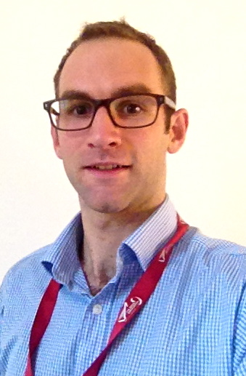
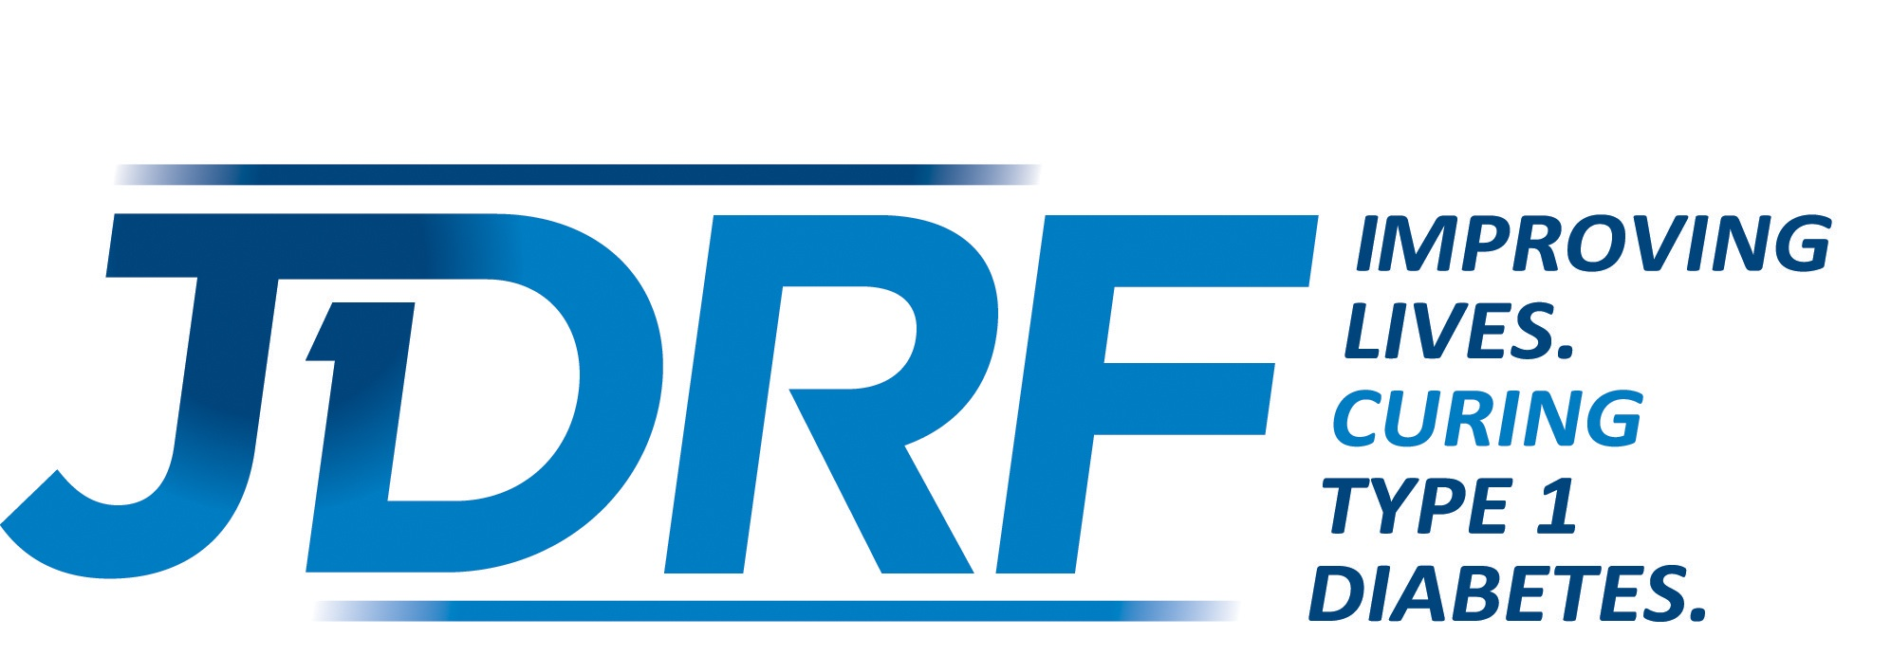
Tell us about your education and background – where are you from, where did you go to school?
I am originally from just South of London in the UK. I studied medicine at Oxford. I have spent most of my postgraduate training in Exeter, where I originally trained in internal medicine, subsequently taking a joint research and clinical post in Andrew Hattersley’s research team. During this fellowship I have undertaken training in kidney medicine and transplantation, whilst developing a research interest, first in the genetics of diabetes, then specifically in type 1 diabetes.
Where do you currently work and what is your position? What does a “day in the life” look like for you?
I currently work in Professor Hattersley’s Exeter Clinical Diabetes Research Group, based at the University of Exeter in the NIHR(National Institute of Health Research) Exeter Clinical Research Facility. I have a Clinical Fellowship, funded by Diabetes UK (The main UK Diabetes charity) and am currently writing up my PhD titled “ The epidemiology, impact and individual assessment of endogenous insulin production in Type 1 Diabetes” Currently, my daily job involves writing my thesis, continuing to analyze data from our recent study of 1000 people with long duration type 1 diabetes, putting the finishing touches to a JDRF grant submisison, managing the recruitment of patients to our ongoing type 1 diabetes studies, and monthly “on calls” for the Kidney unit.
Why diabetes? How did you get involved in diabetes and/or what made you want to work in diabetes research?
As a kidney specialist, Diabetes is by far the most common cause of kidney disease. In kidney and transplant clinics we see some of the most unlucky patients who have severe kidney problems and are faced with difficult choices about transplantation and dialysis. Like most clinicians, I have many patients who I am very fond of and who are a very strong motivation to try and improve the care and prospects for people with type 1 diabetes. I also have colleagues and friends with type 1 diabetes who are a constant source of inspiration. I started my PhD thinking about trying to understand beta cell function after islet or pancreas transplant, but this has led me to realize that we still need to understand much more about the original disease process in type 1 diabetes. During my PhD I have become increasingly motivated to try and understand the disease process in type 1 diabetes, with the long term goal of this better understanding leading to new treatments to ultimately treat, prevent, or cure.
Tell us about your research. (Please describe for parents and patients new to T1D, or for someone who requires a simplified explanation.)
Type 1 diabetes is classically thought to lead to autoimmune destruction of all insulin producing beta cells of the pancreas within the first few months or years after diagnosis. Increasingly we now realize that not all beta cells are destroyed, and that many people go on making very tiny amounts of their own insulin even many years from diagnosis. There are also some unusual patients who still make quite high levels of insulin despite many years of type 1 diabetes. These findings suggest there are key things to learn about why some beta cells are not destroyed by the immune system, another key question this raises is can beta cells regenerate. Understanding exactly why people with T1D carry on making tiny amount of insulin may provide a crucial piece of the jigsaw of understanding the disease.
We and several teams throughout the world are trying to address whether small amounts of persisting insulin production can make a difference to patients (by reducing the risk of kidney and eye complications and hypoglycaemia), we are also trying to understand the genetic and immune reasons that some people with type 1 diabetes keep endogenous insulin and others don’t.
What are your thoughts on the progress being made in T1D research as a whole?
There are many new and exciting avenues but there is still much hard work to do. If we look at the mission statement of the JDRF - “To better treat, prevent and cure type1 diabetes”. Treatment is really improving all the time through improvements in technology such as closed loops systems, and better options regarding transplantation. However we have not reached a point where we can prevent or cure T1D. That is a real challenge for researchers to tackle. I believe we will need to better understand the biology of type 1 diabetes and the underlying disease process before we are able to do this.
Why is diabetes research so important?
It is important because diabetes is such a common disease, and it affects people of all ages, from newborn babies , to young children, teenagers and adults. The impact of diabetes on individuals with the disease and their families is huge and relates not just to the treatment needed but also the chronic complications such as eye and kidney problems. This has a knock on impact to the whole of society and obviously makes it very important to try and find ways to prevent or cure diabetes.
Do you have anything extra you would like to share? Is there anyone to thank or acknowledge? (mentors, patients, families) Can you comment on the need for funds from sources such as JDRF?
I have a huge number of people to thank for the good fortune I have had with my work to date….
My two mentors Andrew Hattersley and Coralie Bingham have taught me (and are still teaching me!) to think critically and take research from an idea, to a study through to getting an answer and telling people about it. There is a fantastic research here team at the University Exeter that includes excellent nurses, administrators, managers, clinicians and scientists. The whole team is very much greater than the sum of its parts, and it really feels like given a challenge, as a group we can really rise to it and make progress as a team
I am extremely grateful to all the patients in our studies, without their dedication and willingness to take part in research, none of what we do would be possible. I am currently funded by a patient focused charity and am humbled by the people who shake the tins and raise the money.
Funding from the JDRF is clearly making a huge different to research on type 1 diabetes. They are in a great position to strategize and coordinate work on improved care for patients with type 1 diabetes, and to coordinate efforts to prevent or cure the disease. We are currently applying for JDRF funding to ask some of the questions I mentioned above, and as someone who wants to have a research career studying type 1 diabetes I have a goal of applying for a JDRF fellowship to help makes this happen.
When you’re not working, what do you like to do for fun?
Spend time with my wife Hannah and our two children Oscar (4) and Matilda (2). I also have a passion for bike racing and riding my bike in the beautiful Devon countryside. I still just about manage to fit this in. I race for the Exeter University high performance team when I can find the time….
Investigator Spotlight: The JDRF-nPOD Scientists Who Seek the Cure for T1D
Each month, we highlight one of the nPOD investigators. Thanks to the fundraising of all the JDRF chapters, these scientists are able to have access to nPOD samples for their work. We’ll let them introduce themselves, tell you about their research, and their lives.
Richard Oram, M.D., Ph.D.(c) (University of Exeter, UK)
1. Tell us about your education and background—where are you from? Where did you go to school?
I’m originally from just south of London in the UK. I studied medicine at Oxford. I’ve spend most of my postgraduate training in Exeter, where I trained in Internal Medicine. Then I took a and clinical post in Dr. Andrew Hattersley’s research team. During this fellowship, I have undertaken training in kidney medicine and transplantation, whilst developing a research—first in genetics of diabetes, then specifically in type 1 diabetes.
2. Where do you currently work and what is your position? What does “a day in the life” look like for you?
I currently work in Professor Hattersley’s Clinical Diabetes Research Group, based at the University of Exeter. I have a Clinical Fellowship, funded by Diabetes UK. I’m currently writing up my Ph.D. titled “The epidemiology, impact and individual assessment of endogenous insulin production in Type 1 Diabetes.”
My daily job involves writing my thesis, continuing to analyze data from our recent study of 1,000 people with long-duration T1D, putting the finishing touches to a JDRF grant submission, managing the recruitment of patients to our ongoing T1D studies, and monthly “on call” for the Kidney Unit.
3. Why diabetes? How did you get involved with diabetes? What made you want to work in diabetes research?
As a kidney specialist, diabetes is by far the most common cause of kidney disease. In kidney and transplant clinics, we see some of the most unlucky patients who have severe kidney problems. They are faced with difficult choices about transplantation and dialysis. Like most clinicians, I have many patients whom I am very fond of, and who provide a very strong motivation for me to try and improve the care and prospects for people with T1D. I also have colleagues and friends with T1D who are a constant source of inspiration.
I started my Ph.D. thinking about trying to understand Beta cell function after islet or pancreas transplant, but this has led me to believe that we still need to understand much more about the original disease process inT1D. During my Ph.D., I have become increasingly motivated to try and understand the disease process, with the long-term goal of this better understanding leading to new treatments to ultimately treat, prevent, or cure.
4. Tell us about your research.
Type 1 diabetes is classically thought to lead to autoimmune destruction of all insulin-producing Beta cells of the pancreas within the first few months or years after diagnosis. Increasingly, we now realize that not all the Beta cells are destroyed, and that many people go on making very tiny amounts of their own insulin even years after diagnosis. There are also some unusual patients who still make quite high levels of insulin despite many years of T1D. These findings suggest that are key things to learn about why some Beta cells are not destroyed by the immune system. Another key question is: Can Beta cells regenerate? Understanding exactly why people with T1D carry on making tiny amounts of insulin may provide a crucial piece of the diabetes jigsaw puzzle.
We—and several other teams around the world—are trying to address whether small amounts of persisting insulin production can make a difference to patients, by reducing the risk of kidney and eye complications, as well as hypoglycemia. We are also trying to understand the genetic and immune reasons that some people with T1D keep endogenous insulin and others don’t.
5. What are your thoughts on the progress being made in T1D as a whole?
There are many new and exciting avenues, but there is still much hard work to do. Look at the mission statement of JDRF, “To better treat, prevent, and cure type 1 diabetes.” Treatment is really improving all the time, through advancements in technology such as closed loop systems, and better options for transplantation. However, we have not reached a point where we can prevent or cure T1D. This is the real challenge for researchers to tackle. I believe we need to better understand the biology of T1D and the the underlying disease process before we are able to do this.
6. Why is diabetes research so important?
It’s important because diabetes is such a common disease, and it affects people of all ages, from newborn babies to young children, teenagers, and adults. The impact of diabetes on individuals and their families is huge, It relates not just to the treatment needed, but also the chronic complications, such as eye and kidney problems. This impacts the whole of society, as well.
7. Do you have anything else you would like to share? Is there anyone to thank or acknowledge? Can you comment on the need for funds from such sources as JDRF?
I have a huge number of people to thank for the good fortune I have had with my work to date… My two mentors, Andrew Hattersely and Coralie Bingham, have taught me (and are still teaching me!) to think critically and take research from an idea to a study, to getting an answer and telling people about it. There is a fantastic research team here at University of Exeter that includes excellent nurses, administrators, managers, clinicians, and scientists. The whole team is very much greater than the sum of its parts. It really feels like, given a challenge, as a group, we an rise to it and make progress as a team.
I am extremely grateful to all the patients in our studies. Without their dedication and willingness to take part in research, none of what we do would be possible. I am currently funded by a patient-focused charity and am humbled by the people who shake the tins and raise the money.
Funding from JDRF is clearly making a huge difference to T1D research. They are in a great position to strategize and coordinate work on improved care for T1D patients, and to coordinate efforts to prevent or cure the disease. We are currently applying for JDRF funding to ask some of the questions I mentioned above. As someone who wants to have a career in T1D research, I have a personal goal of obtaining a JDRF Fellowship to make this happen.
8. When you’re not working, what do you like to do for fun?
Spend time with my wife, Hannah, and our two children, Oscar (4) and Matilda (2). I also have a passion for bike racing and riding my bike in the beautiful Devon countryside. I still just about manage to fit this in. I race for the Exeter University high-performance team when I can find the time…
For more information about nPOD, visit us at www.jdrfnpod.org

